Slide 1
Module 2 ..part2..IRS information retrieval models
1) covered till date
1.1) process of retrieval….user side (query,keywords) IR system side(Database , documents, indexing tokens), process working comparison, keywords & tokens, ranking, results
1.2) main problem …accuracy of ranking algorithm
1.3) solution….introduction of IR models
1.4) basic retrieval system…..user profile, filtering algorithm, database manager, database or storage
1.5) Process of retrieval….user profile as per user query, query indexing and document indexing, comparison of both, results as per finding
1.6) limitation.. A user query may not be proper theirfore improper query indexing thus irreverent results
1

Slide 2
Module 2 ..part2..IRS information retrieval models
I
1) covered till date
1.7) solution.. user will be given feedback so as to modify his query of required
1.8) taxonomy of information system….so as to define IR models and the methods used in it
1.9) user task….only browsing or actual information retravel
1.10) only browsing…searching , hyperlinks
1.11) retrieval …ad-hoc and filtering
1.12) adhoc…..query may change but number of document collection same
1.13) filtering…same query…set of document collection may change

Slide 3
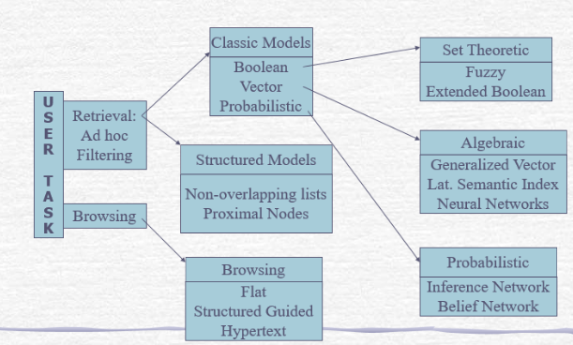
Module 2 ..part2..IR models
(1)taxonomy of Information retrieval system

Slide 4
Module 2 ..part2..IR models
(1)taxonomy of Information retrieval system
1.2(User task…information retrieval….users operational modes…filtering
Operational mode two: Filtering…
User profile
Filtering algorithm
Data base manager
database
User inputs

Slide 5
Module2 ..part2..IR model
1.3)IR system with feedback
User input
User profile
Filtering algorithm
database manager
database
Search feedback

Slide 6
Module2 ..part2..IR model
2) Browsing….
a) Basically it is a orientation strategy.
b) It is a process of finding some reliance with the search contents it have
2.1) Types of browsing…….
2.1.a) Flat browsing mode…..
a) The Flat Browsing mode is a special browsing mode where the Browser displays the files ‘as it is’, i.e in raw form without breaking the path to folders, exactly as they are stored on the website in the database.
b)The query is sent and the entire document is retrieved were every there is matching of query contents and document contents.
c) The browser travels in a sequence from one site to another retrieving the documents of match

Slide 7
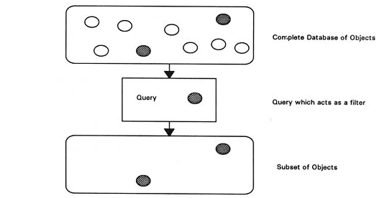
Module2 ..part2..IR model
2) Browsing….2.1) Types of browsing…….
2.1.a) Flat browsing mode…..
d) Documents arranged as list of search results

Slide 8
Module2 ..part2..IR model
2)Browsing….2.1)Types…2.1.b) Flat hypertext:
a)this does go in a sequence from site to site and page to page within a site but directly jumps to the object within the pages were every the hypertext query is directed.
b)This is type of nonsequential search i.e its starts sequentially from page to page(till no match) but once within a page may directly jump to a hyperlinked object ( within page or another page)
c) It is link node and link structure were the nodes can be the pages of a book and by the link connected from page 1 to page directly the jump can be from page 1 to page 6
2.1.c) Structured guided hypertext
a)This is in form of directory structure i.e main directory, subdirectories, folders files within folders, pages within the files , contents within the file
b)It has both forward and backward path i.e its structure is not lost during browsing

Slide 9
Module2 ..part2..IR model
2)Browsing….2.1)Types…2.1.c) Structured guided hypertext…..cont
c) It is like the index of a book
d) The history showns which pages are visited
2.2) Conclusion….
a) for user task…..two task user does…..browsing (only searching) and retrieval (searching & getting back the results)
b) Retrieval by adoc ( query change)and filtering( document number changes)

Slide 10
Module2 ..part2..IR model
3) Information retrieval Models
3.1)Why model is required
c
Solution
number of solutions
Selected the best
Perception
Analyzing the solution
Conceptualization
Clear understanding of solution
Characterization
Parameters to be considered
Problem
Defining
understanding
Defining the define the solution space
problem space
Modelling
Model
representation

Slide 11
Module2 ..part2..IR model
3) Information retrieval Models
3.1)Why model is required
a)It defines the boundary within which each unit works and the sequence in which they will be working.
b)The mathematical modeling of various subunits makes the working of the model more clear and justifiable thus implementable and testable
c)As it is in form of units each unit can be designed independently and then connected
d)They make it clear the final input and output along with the intermediate inputs and outputs
e) This acts as a blue print for actual implementation
f) It also provides means for further research and study so as to refine the model
g) The model for IR usually help in predicting as what the output search will be for……

Slide 12
Module2 ..part2..IR model
3) Information retrieval Models
3.1)Why model is required ……
g)….user query
h)This can be tested experimentally in a controlled environment before implementing
4) Components of IR model……..
4.1.a) Acquisition: In this step, the selection of documents and other objects from various web resources that consist of text-based documents takes place. The required data is collected by web crawlers and stored in the database.
4.1.b) Representation: It consists of indexing that contains free-text terms, controlled vocabulary, manual & automatic techniques as well. example: Abstracting contains summarizing and Bibliographic description that contains author, title, sources, data, and metadata.

Slide 13
Module2 ..part2..IR model
4) Components of IR model…….cont
4.1,c) File Organization: There are three types of file organization methods. i.e. Sequential: It contains documents by document data. (document based)
Inverted: It contains term by term, list of records under each term.(content based)
Mixed: Combination of both.
4.1.d) Query: An IR process starts when a user enters a query into the system.
Queries are formal statements of information needs, for example, search strings in web search engines.
In information retrieval, a query does not uniquely identify a single object in the collection. Instead, several objects may match the query, perhaps with different degrees of relevancy.

Slide 14
Module2 ..part2..IR model
5) Characterization of models…
This defines what the IR model consist of as its parameters. By defining these parameters as high and low, the requirement of the IR model can be defined
The actual measurement of these parameter value can thus be used to evaluate the IR model
IR= f(D,Q, F(D Q) ,R(Qi, Dj)
Where D: set of logical views or representation of the document stored.
Q: set of logical representation of the documents for the user so as to form his query
F: F(D,Q) Framework used. This is required for modelling the document representation (user, logical database) , their relationship and queries
R(Qi, Dj): this is the ranking function used. Qi is the ith query and Dj is the jth document representation.

Slide 15
Module2 ..part2..IR model
5) Characterization of models…cont
This gives the association of the query with the Document selected i.e ith query gives document ranking from from 1 to j
Now the index thus has to be weighted as per their nearness of relevance with the query search
K: index terms from (0 to i)
D: number of documents(0 to j)
Weight associated with index terms will be Wi,j
Where the index term not appearing in the document for this Wi.j=0
G(Dj):Wi,j(N) : G is the function associated with documents dj were the index term matches and the relevance is the weight associated as Wi,j(number) were N is the number

Slide 16
Module2 ..part2..IR model
6) Types of models in IR…6.1) as per taxonomy……classic Models and structured Models
6.1.a) Classic model…
This models requires a set of index terms called as tokens for representation of each document ( it can be like a one sentence summary of main token of that document)
Index term is documents set of words whose semantic helps in representing the document main theme.
Thus index terms summarized a document content in a single sentence.
Basically it is a set of nouns picked up from the document as nouns have meaning which reflect the contents of the entire document
Thus large number of index terms can be formed for a set of documents
Which index term resenbles most to the user query so as to give most relevant results is very important

Slide 17
Module2 ..part2..IR model
6) Types of models in IR…6.1) as per taxonomy……classic Models and structured Models
6.1.a) Classic model…
Ranking of document s with relevance in number and meaning of tokens (index terms) with keywords
Set of documents
Tokens
Empty spaces
Numbers
words
Most relevant
Words
Proper nouns
(index)
Index subset of tokens
RANKING
All those documents ranked as per maximum number of index terms found in it
Comparison
of index term with keywords of users query

Slide 18
Module2 ..part2..IRS
Thank You

